Slide 1



İŞLETİM SİSTEMLERİ
UYGULAMA-4

Slide 2
Section Outline
Multi-threading
Synchronization
Mutexes
Conditional Variables
Semaphores

Slide 3
Threads vs. Processes
Creation of a new process using fork is expensive (time & memory).
A thread (sometimes called a lightweight process) does not require lots of memory or startup time.

Slide 4
fork()
Process A
Global
Variables
Process B
Global
Variables
fork()
Code
Code
Stack
Stack

Slide 5
pthread_create()
Process A
Thread 1
Global
Variables
pthread_create()
Code
Process A
Thread 2
Stack
Stack

Slide 6
Multiple Threads
Each process can include many threads.
All threads of a process share:
memory (program code and global data)
open file/socket descriptors
signal handlers and signal dispositions
working environment (current directory, user ID, etc.)

Slide 7
Thread-specific Resources
Each thread has its own
Thread ID
Stack, Registers, Program Counter
errno (if not - errno would be useless!)
Threads within the same process can communicate using shared memory.
Must be done carefully

Slide 8
Posix Threads
We will focus on Posix Threads - most widely supported threads programming API.
you need to link with “-lpthread”
On many systems this also forces the compiler to link in re-entrant libraries (instead of plain vanilla C libraries).

Slide 9
Thread Creation
pthread_create(
pthread_t *tid,
const pthread_attr_t *attr,
void *(*func)(void *),
void *arg);
func is the function to be called.
when func() returns the thread is terminated.

Slide 10
pthread_create()
The return value is 0 for OK.
positive error number on error.
Does not set errno !!!
Thread ID is returned in tid

Slide 11
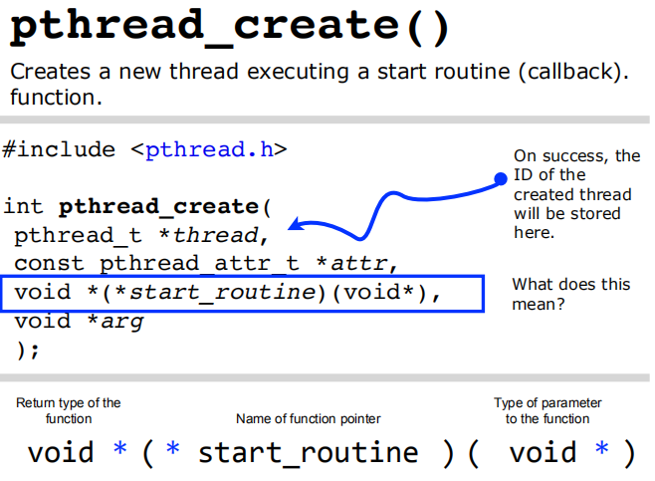

Slide 12
Thread IDs
Each thread has a unique ID, a thread can find out it's ID by calling pthread_self().
Thread IDs are of type pthread_t which is usually an unsigned int. When debugging, it's often useful to do something like this:
printf("Thread %u:\n",pthread_self());

Slide 13
Thread Arguments
When func() is called the value arg specified in the call to pthread_create() is passed as a parameter.
func can have only 1 parameter, and it can't be larger than the size of a void *. (on a 64-bit system -> 8 bytes)

Slide 14
Thread Arguments (cont.)
Complex parameters can be passed by creating a structure and passing the address of the structure.
The structure can't be a local variable (of the function calling pthread_create)!!
threads have different stacks!

Slide 15
Thread args example
struct { int x,y } 2ints;
void *blah( void *arg) {
struct 2ints *foo = (struct 2ints *) arg;
printf("%u sum of %d and %d is %d\n",
pthread_self(),
foo->x, foo->y,
foo->x+foo->y);
return(NULL);
}

Slide 16
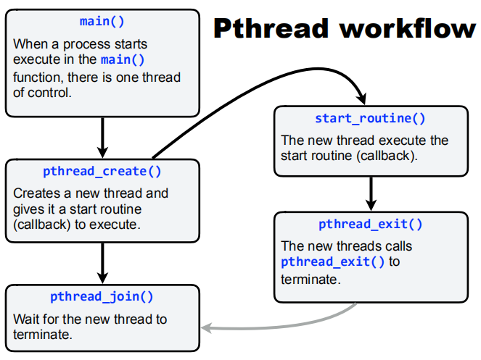

Slide 17
Thread Lifespan
Once a thread is created, it starts executing the function func() specified in the call to pthread_create().
If func() returns, the thread is terminated.
A thread can also be terminated by calling pthread_exit().
If main() returns or any thread calls exit()all threads are terminated.

Slide 18
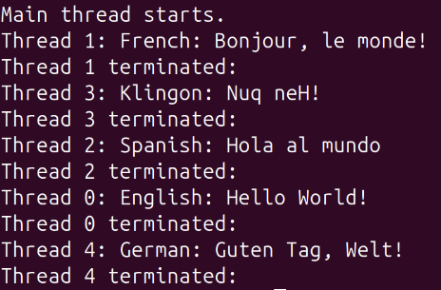
Ex_1_pthread1.c

Slide 19
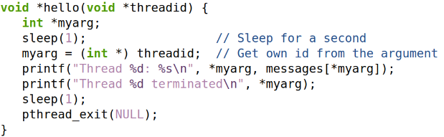
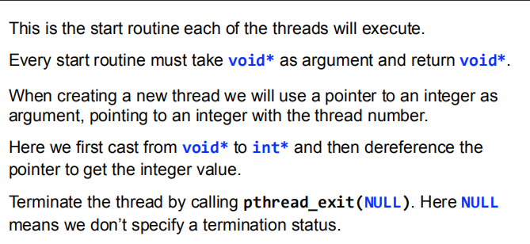

Slide 20
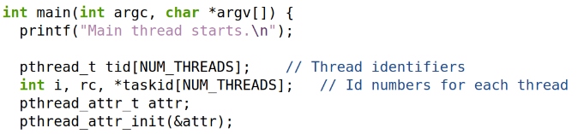
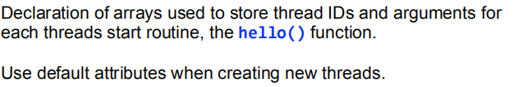

Slide 21
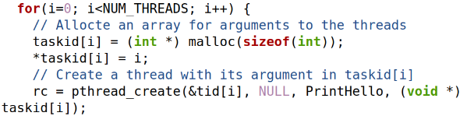
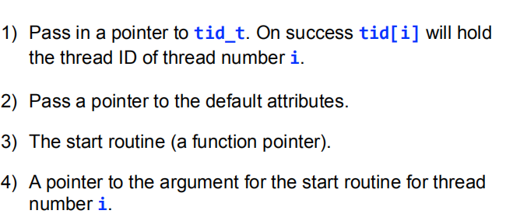

Slide 22
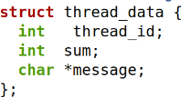
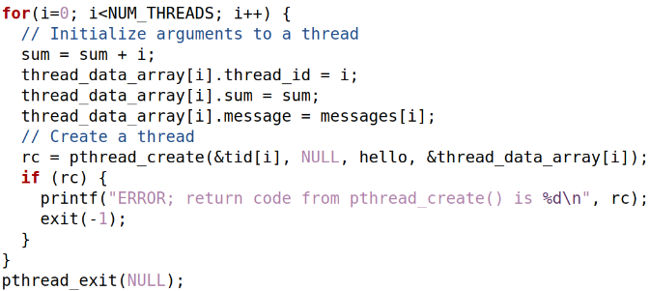
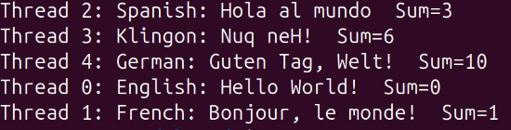
Passing multiple arguments to threads
Ex_2_pthread2.c

Slide 23
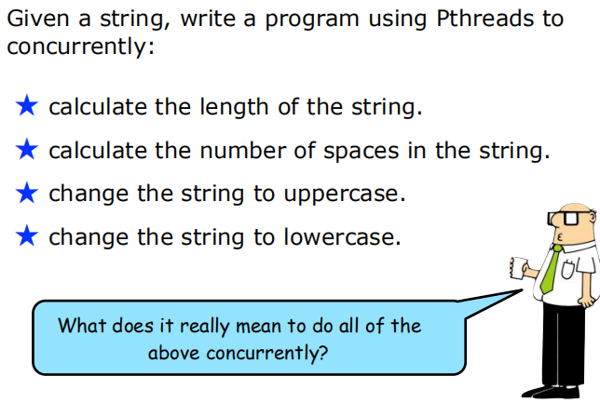

Slide 24
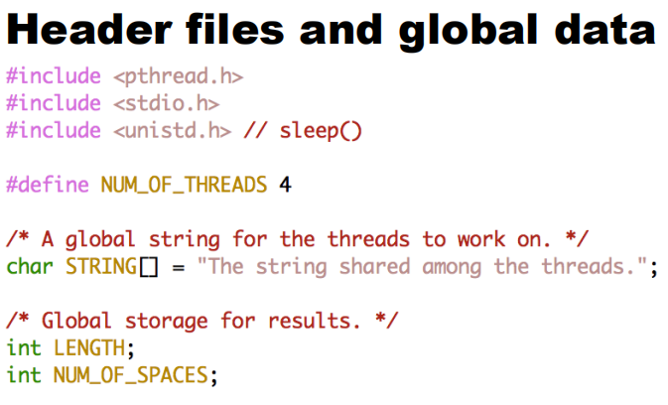
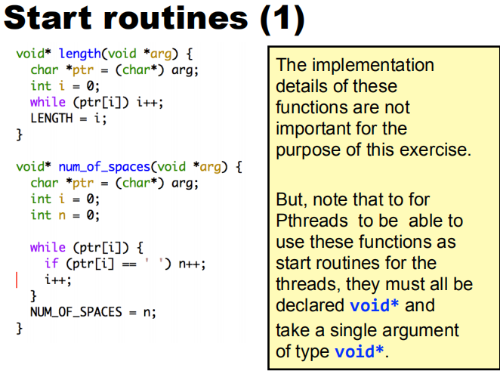

Slide 25
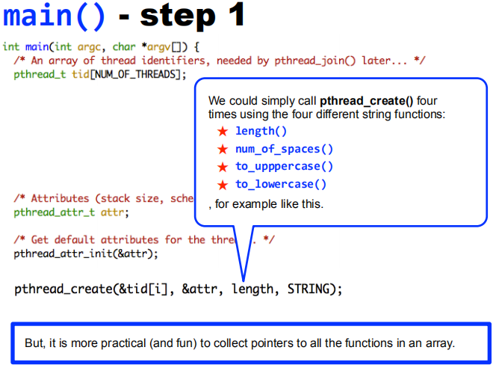
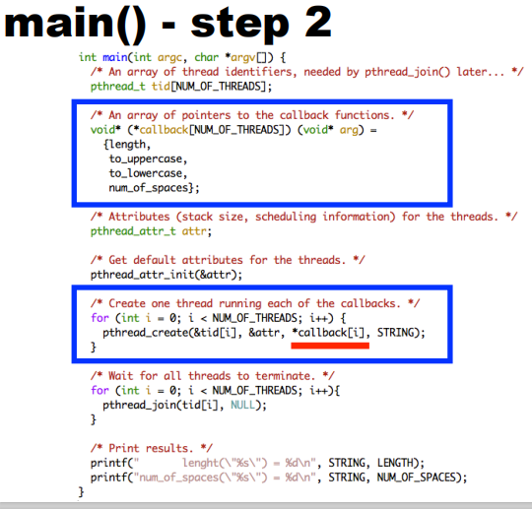

Slide 26
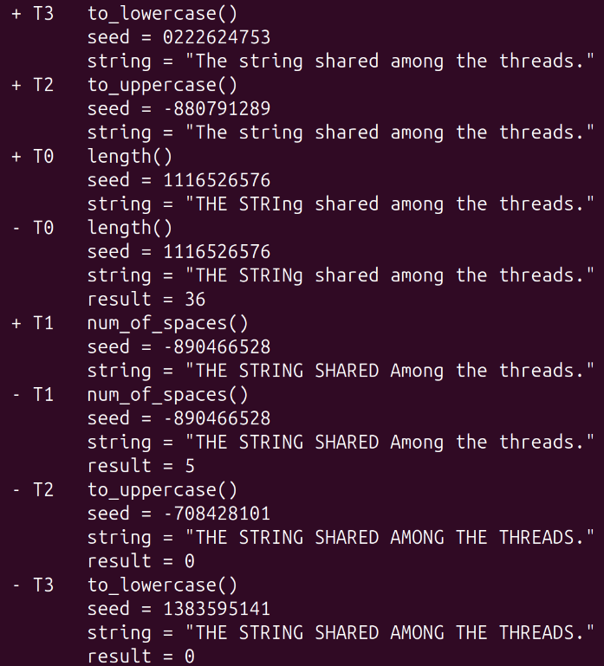
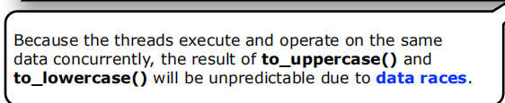
Ex_3_pthread3.c

Slide 27
Joinable vs. Detached (Contd.)
Each thread can be either joinable or detached.
Joinable: on thread termination the thread ID and exit status are saved by the OS.
Detached: on termination all thread resources are released by the OS. A detached thread cannot be joined.

Slide 28
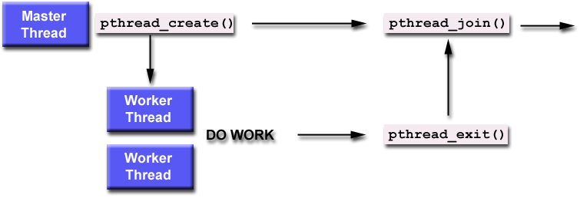
Joinable vs. Detached (Contd.)

Slide 29
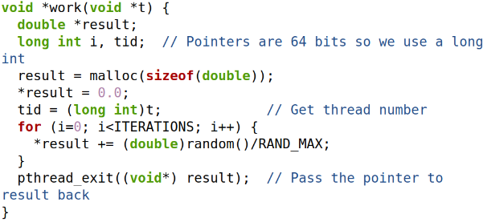
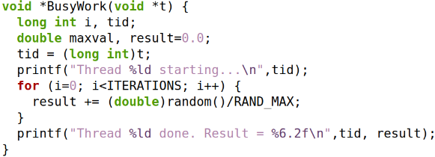
Joinable vs. Detached (Contd.)
Main thread first joins and then exit (waits for completion of threads):
Main thread exits after creating the threads:
Ex_4_pthread4.c
Ex_5_pthread5.c

Slide 30
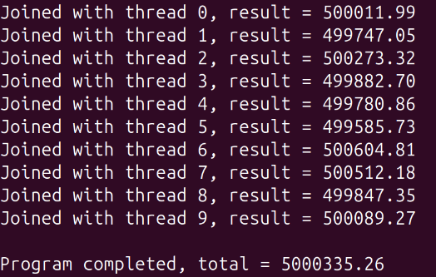
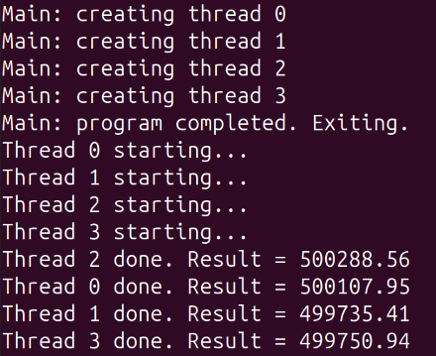
Joinable vs. Detached (Contd.)
Ex_4_pthread4.c
Ex_5_pthread5.c

Slide 31
Shared Global Variables
Possible problems
Global variables
Avoiding problems
Synchronization Methods
Mutexes
Condition variables

Slide 32
Possible problems
Sharing global variables is dangerous - two threads may attempt to modify the same variable at the same time.
Just because you don't see a problem when running your code doesn't mean it can't and won't happen.

Slide 33
Avoiding problems
pthreads includes support for Mutual Exclusion primitives that can be used to protect against this problem.
The general idea is to lock something before accessing global variables and to unlock as soon as you are done.
Shared socket descriptors should be treated as global variables!!!

Slide 34
Mutexes
Ex_6_pthread6.c
Ex_7_pthread7.c
A global variable of type pthread_mutex_t is required:
pthread_mutex_t counter_mtx = PTHREAD_MUTEX_INITIALIZER;
Initialization to PTHREAD_MUTEX_INITIALIZER is required for a static variable!

Slide 35
Lock & Unlock
To lock use:
pthread_mutex_lock(pthread_mutex_t &);
To unlock use:
pthread_mutex_unlock(pthread_mutex_t &);

Slide 36
Condition Variables
pthreads support condition variables, which allow one thread to wait (sleep) for an event generated by any other thread.
This allows us to avoid the busy waiting problem.
pthread_cond_t foo = PTHREAD_COND_INITIALIZER;

Slide 37
Condition Variables (cont.)
A condition variable is always used with mutex.
pthread_cond_wait(pthread_cond_t *cptr,
pthread_mutex_t *mptr);
pthread_cond_signal(pthread_cond_t *cptr);
Ex_8_pthread8.c
don’t let the word signal confuse you -
this has nothing to do with Unix signals

Slide 38
Summary
Threads are awesome, but dangerous. You have to pay attention to details or it's easy to end up with code that is incorrect (doesn't always work, or hangs in deadlock).
Posix threads provides support for mutual exclusion, condition variables and thread-specific data.
IHOP serves breakfast 24 hours a day!

Slide 39
Semaphores
A semaphore is a data structure that is shared by several processes.
Semaphores are most often used to synchronize operations, when multiple processes access a common, non-shareable resource.
By using semaphores, we attempt to avoid other multi-programming problems such as:
Starvation
Deadlock

Slide 40
POSIX Semaphores
POSIX semaphores allow processes and threads to synchronize their actions.
A semaphore is an integer whose value is never allowed to fall below zero.
POSIX semaphores come in two forms:
named semaphores
unnamed semaphores.

Slide 41
Named Semaphores
A named semaphore is identified by a name of the form /somename; that is, a null-terminated string
Two processes can operate on the same named semaphore by passing the same name to sem_open().
Named semaphore functions
sem_open()
sem_post()
sem_wait(), sem_timedwait(), sem_trywait()
sem_close()
sem_unlink()

Slide 42
Unnamed Semaphores
An unnamed semaphore does not have a name.
The semaphore is placed in a region of memory that is shared between multiple threads or processes.
A thread-shared semaphore
a global variable.
A process-shared semaphore
must be placed in a shared memory region
POSIX or System V shared memory segment

Slide 43
Unnamed Semaphores
Unnamed semaphore functions
sem_init()
sem_post()
sem_wait(), sem_timedwait(), sem_trywait()
sem_destroy()

Slide 44
Summary
Named Semaphore | Unnamed Semaphore
Identified by a unique name (e.g., /somename). | Identified through a memory address.
Opened with sem_open(); different processes can access it by using the same name. | Initialized with sem_init() in a shared memory region or global variable accessible to threads/processes.
Accessible in whole system with name | Only accessible within shared memory between threads/processes
sem_open(), sem_post(), sem_wait(), sem_timedwait(), sem_trywait(), sem_close(), sem_unlink() | sem_init(), sem_post(), sem_wait(), sem_timedwait(), sem_trywait(), sem_destroy()
Managed by the operating system as a named resource. | Lives in user-defined shared memory regions or global variables.
To clean up: sem_close() + sem_unlink() | Use sem_destroy() to clean it up when no longer needed.

Slide 45
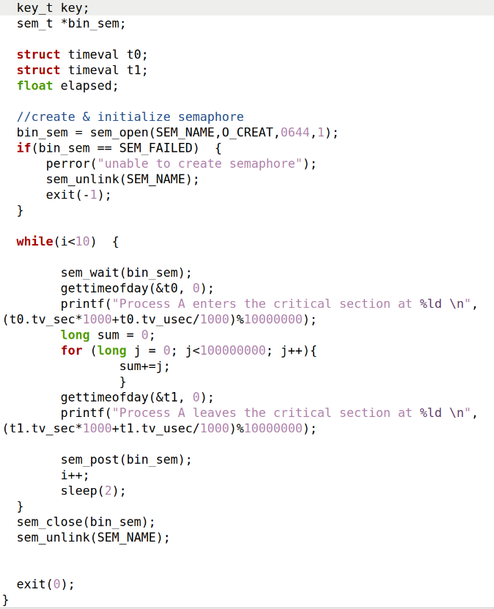
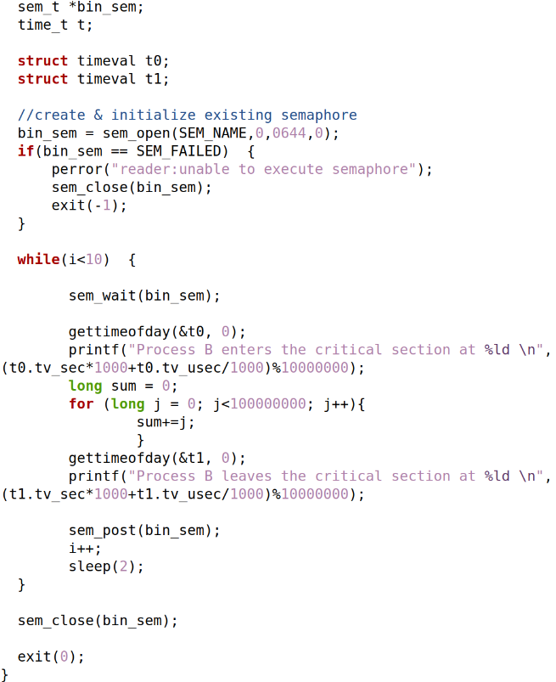
A simple semaphore example
sem_t *bin_sem;
(pointer to semaphore)
Name of semaphore
Behavior of semaphore (Create the semaphore)
File permission
Owner (6): R/W Group (4): R-only Others (4): R-only
SEM_NAME 0: Assumes semaphore exist
0644 permission
0: starting count
Starting count
(1: unlocked)
Closes the semaphore object
Deletes the named semaphore
Ex_3_semA.c
Ex_3_semB.c

Slide 46
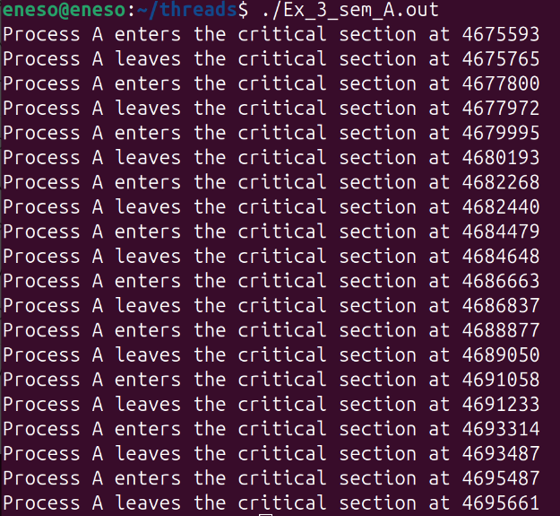
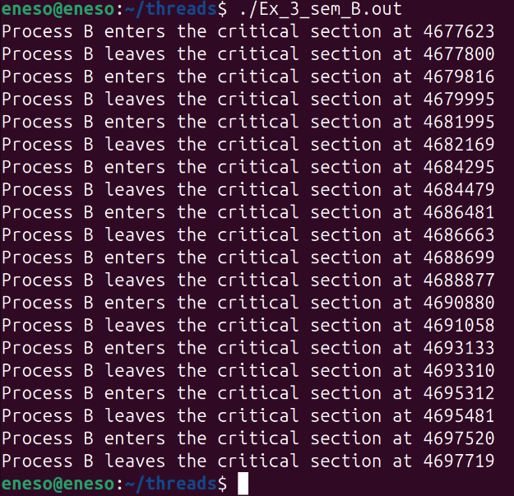
A simple semaphore example
Ex_3_semA.c
Ex_3_semB.c

Slide 47
Producer-Consumer Problem
Problem:
Producer might overwrite the buffer when full.
Consumer might read invalid data when buffer is empty.
Semaphores control access to the shared buffer:
1st semaphore, tracks the number of empty slots in the buffer.
2nd semaphore, tracks the number of filled slots in the buffer.
create a shared memory
SystemV
semaphore groups
create
2 semaphores

Slide 48
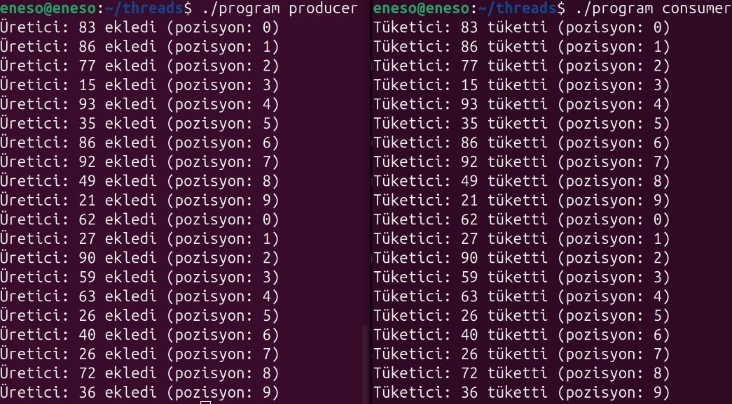
ProdConsTwoProcess.c
sem_wait(sem_id, 1)
cons. waits until resource available
sem_signal(sem_id, 1)
resource available
in the buffer
sem_wait(sem_id, 0)
prod. waits until a slot opens
sem_signal(sem_id, 0)
cons. releases a slot

Slide 49
1-In a typical OS, which of the following is shared among threads of the same process?
A. Program counter B. Stack memory C. Heap memory D. Register set
Notes:
c

Slide 50
2-Which of the following actions can safely be performed by multiple threads simultaneously WITHOUT causing a race condition?
A. Writing to the same global variable B. Calling a pure function with no side effects C. Updating a shared counter D. Modifying a process-wide linked list
Notes:
B

Slide 51
3-Which situation BEST describes a deadlock in multithreaded programs?
A. A thread repeatedly retries an operation and makes no progress B. Multiple threads wait indefinitely for resources held by each other C. A thread terminates unexpectedly D. Threads completing tasks in the wrong order
Notes:
B

Slide 52
4-Consider the following statements about context switching between threads:
It requires saving/restoring registers
It always requires switching address spaces
It can occur on a single CPU system
It only happens when a thread voluntarily yields
Which statements are TRUE? A. 1 and 3 B. 2 and 4 C. 1, 2, and 3 D. 1, 3, and 4
Notes:
A

Slide 53
5- Which statement correctly describes inter-process communication (IPC) compared to thread communication?
A. IPC is faster because processes share the same memory B. IPC is slower because it usually requires kernel involvement C. Threads cannot communicate without the kernel D. Signals are only usable for threads, not processes
Notes:
B

Slide 54
1- What issue exists in this threading code?
void *task(void *arg) {
int *data = (int *)arg;
printf("%d\n", *data);
return NULL;
}
int start() {
int local = 99;
pthread_t t;
pthread_create(&t, NULL, task, &local);
return 0; // <-- Problem
}
A. None; prints 99 correctly B. Deadlock C. Out of Scope D. Memory leak
Notes:
C
Passing pointer to stack variable that goes out of scope (dangling pointer)

Slide 55
void* print_msg(void* arg) {
printf("Running\n");
return 0; // returns integer instead of pointer
}
int main() {
pthread_t t;
pthread_create(&t, NULL, print_msg, NULL);
pthread_join(t, NULL);
}
What goes wrong?
A. Undefined Behavior B. Thread returns too early C. Thread never terminates D. pthread_join blocks forever
Notes:
Returning an integer where a void* is expected causes undefined behavior
A

Slide 56
void* work(void* arg) {
sleep(2);
printf("Work done\n");
return NULL;
}
int main() {
pthread_t t;
pthread_create(&t, NULL, work, NULL);
pthread_detach(t);
return 0;
}
What happens?
A. Undefined behavior
B. Program always prints “Work done”
C. Thread is forcibly killed when main exits
D. The thread continues running even after main ends
Notes:
C

Slide 57
pthread_t t;
void* task(void* arg) {
return NULL;
}
int main() {
pthread_create(&t, NULL, task, NULL);
pthread_join(t, NULL);
pthread_join(t, NULL); // second join
}
What happens?
A. Thread runs twice
B. Second join crashes or returns an error
C. Thread becomes detached
D. Second join retrieves same return value
Notes:
B — joining an already joined thread is undefined.

Slide 58
1-What does the following program print?
int x = 0;
void *thread_func(void *arg) {
x++;
return NULL;
}
int main() {
pthread_t t1, t2;
pthread_create(&t1, NULL, thread_func, NULL);
pthread_create(&t2, NULL, thread_func, NULL);
pthread_join(t1, NULL);
pthread_join(t2, NULL);
printf("%d\n", x);
}
A. Always 2 B. Always 1 C. 1 or 2 depending on scheduling (race condition) D. Compiler error
Notes:
C

Slide 59
2-char* buffer = NULL;
void* routine(void* unused) {
if (buffer == NULL)
buffer = malloc(100);
memset(buffer, 0, 100);
return NULL;
}
Two threads call this concurrently.
What can happen?
A. Double malloc and memory leak
B. Segmentation fault
C. Corruption of buffer contents
D. All of the above
Notes:
D

Slide 60
3- if (!flag)
flag = 1;
Two threads execute this.
What behavior is possible?
A. One thread always sets flag, the other always skips
B. Both threads may set flag simultaneously
C. flag is write-only
D. Compiler prevents races
Notes:
B

Slide 61
4- int ready = 0;
int data;
void* producer(void*) {
data = 42;
ready = 1;
}
void* consumer(void*) {
while (!ready);
printf("%d", data);
}
Which of the following is TRUE when producer and consumer are run concurrently by two threads?
A. busy-waiting is slow but safe
B. consumer may see ready = 1 but old value of data
C. printf can reorder memory
D. producer may run twice
Notes:
B

Slide 62
1- int counter = 0; pthread_mutex_t m = PTHREAD_MUTEX_INITIALIZER;
void* t_func(void* arg) {
pthread_mutex_lock(&m);
counter++;
pthread_mutex_unlock(&m);
return NULL;}
int main() {
pthread_t t[5];
for (int i = 0; i < 5; i++)
pthread_create(&t[i], NULL, t_func, NULL);
for (int i = 0; i < 5; i++)
pthread_join(t[i], NULL);
printf("%d\n", counter);}
What will be printed?
A. Always 5
B. Between 0–5
C. Undefined behavior
D. Always 1
Notes:
A

Slide 63
2-pthread_mutex_t m = PTHREAD_MUTEX_INITIALIZER;
pthread_mutex_unlock(&m);
What happens when you run this code?
A. Unlock succeeds normally
B. Undefined behavior — unlocking an unlocked mutex
C. Mutex automatically locks itself
D. Deadlock occurs
Notes:
B

Slide 64
3-void f() {
pthread_mutex_t m = PTHREAD_MUTEX_INITIALIZER;
pthread_mutex_lock(&m);
// do work
pthread_mutex_unlock(&m);
}
What is the main problem with this code in a multithreaded program?
A. Locking a local mutex is fine
B. Mutex is Local
C. Mutex automatically protects all threads
D. Unlocking a local mutex causes deadlock
Notes:
Mutex m is local — threads cannot share it → does not protect anything
B

Slide 65
4-Which of the following can reduce mutex performance in multithreaded programs?
A. Contention on a single mutex by many threads B. Using recursive mutex unnecessarily C. Locking large critical sections D. All of the above
Notes:
D

Slide 66
5-What is the main reason pthread_cond_wait requires the mutex to be locked before calling it?
A. Prevent deadlock B. Allow the OS to schedule properly C. Atomically release the lock while sleeping D. Make sure signal reaches the right thread
Notes:
C

Slide 67
6-pthread_mutex_lock(&m);
if (ready == 0)
pthread_cond_wait(&cv, &m);
pthread_mutex_unlock(&m);
// use data
What is wrong with this code?
A. Should use a loop instead of if
B. Should signal before waiting
C. ready cannot be checked with a mutex
D. Wait must be after unlock
Notes:
A
(Spurious wakeups or multiple consumers require while (!ready).)

Slide 68
1-Which of the following best describes a semaphore?
A. A lock that can only be acquired by one thread B. A counter used for signaling between threads or processes C. A hardware register used for memory protection D. A mechanism for duplicating processes
Notes:
B

Slide 69
2- Semaphore S = 0;
Thread A:
produce_item()
V(S)
Thread B:
P(S)
consume_item()
What does this achieve?
(P-> Probeer (try) and V->Verhoog (increment).)
A. Mutual exclusion
B. Prevents Thread B from starting
C. Synchronization: B waits until A signals
D. Deadlock
Notes:
C

Slide 70
3- Which scenario is best suited for a counting semaphore?
A. Enforcing exclusive access to a variable B. Preventing context switching C. Waking exactly one waiting thread D. Representing a pool of resources
Notes:
D

Slide 71
4- What is a deadlock-prone misuse of semaphores?
A. Using P() then V() in the same order everywhere B. Using V() before P() C. Acquiring two semaphores in different orders in different threads D. Initializing a semaphore to 1
Notes:
C

Slide 72
5- What behavior is associated with a semaphore initialized to 0?
A. It allows one thread to enter immediately B. It acts as a lock C. It forces threads to wait until a signal is sent D. It represents an unlocked mutex
Notes:
C

Slide 73
6- If a process calls fork() before calling P(S), which of the following is true?
A. Both parent and child may independently decrement S B. Only parent may call P(S); child is blocked C. The semaphore becomes unusable D. Fork duplicates the semaphore into two isolated copies
Notes:
A

Slide 74
7- Why is using a local semaphore for synchronization between parent and child after fork unsafe?
A. Parent and child operate on independent copies, so P/V calls do not synchronize B. Local semaphores are automatically shared by the kernel C. The child will always inherit the lock and deadlock D. Local semaphores cannot be initialized
Notes:
A

Slide 75
References
https://github.com/uu-os-2019/
Getting Started With POSIX Threads by Tom Wagner & Don Towsley Department of Computer Science University of Massachusetts at Amherst July 19, 1995

